Slide 1
Level of Detail Expressions
John F. Tripp

Slide 2
Exploring Calculations in Tableau
Level of Detail Expressions
  FIXED
  INCLUDE
  EXCLUDE

Slide 3
Level of Detail
Remember that we generally set our “level of detail” in two places
  Columns and Rows
  Detail Shelf

Slide 4
Level of Detail
The level of detail in the columns and rows + the detail shelf defines how the visualization will be rendered
We use level of detail expressions when we don’t want to use the other options - why?
  Because we want to create a calculation that is independent from the dimensions used to make the visualization

Slide 5
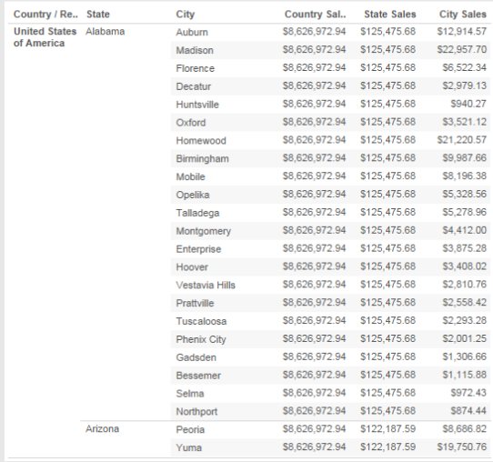
Level of Detail
Level of Detail expressions allow us to produce graphs with calculations at multiple levels at the same time
Could not do this with typical drag and drop functionality in Tableau

Slide 6
Syntax
SUM/AVG/MIN/MAX, etc.
  {LOD TYPE [dim1], [dim2],…,[dimN] : aggregate expression }
Dimensions are optional.
Examples
  {FIXED : Sum([Sales])}
  {EXCLUDE [City], [State] : Sum([Sales])}
  {INCLUDE [Customer Name]: Sum([Sales])}

Slide 7
Syntax
All LOD expressions have the same syntax…
{EXCLUDE [dim1], [dim2],…,[dimN] : aggregate expression}
{INCLUDE[dim1], [dim2],…,[dimN] : aggregate expression}
{FIXED [dim1], [dim2],…,[dimN] : aggregate expression}
All functions take optional dimensions, but:
  EXCLUDE AND INCLUDE do not make sense without including at least one dimension.
  FIXED will regularly be used without dimensions

Slide 8
One of the more powerful features in Tableau
EVERY data analyst position interview that mentions Tableau will ask questions about these LOD functions.
One of the “power multipliers” as far as what you can do in your visualizations.

